Slide 3
What was Jesus’ mission?
(Lk. 19:10) Jesus said,
“The Son of Man has come to seek and to save that which was lost.”
Whether it’s a lost sheep, a lost coin, or a lost son,
Jesus “rejoices” in saving lost people (Lk. 15:5, 9, 32).

Slide 4
What is our mission?
(Jn. 17:18) Jesus prayed,
“Just as you sent me into the world,
I am sending them into the world.”
(Jn. 20:21) Jesus said,
“As the Father has sent me,
so I am sending you.”

Slide 5
What is our mission?
(Mt. 28:18) Jesus said,
“All authority has been given to Me in heaven and on earth.”

Slide 6
What is our mission?
(Mt. 28:19-20) “Go and make disciples of all the nations, baptizing them in the name of the Father and the Son and the Holy Spirit, teaching them to observe all that I commanded you.
Behold, I am with you always, even to the end of the age.”
“Why don’t I sense God moving in my life?”
Luke 12:11-12; Acts 1:8; 4:29-31; James 5:17-18

Slide 8
“Good news” (euangelion)
When you talk about being a Christian?

Slide 9
“Good news” (euangelion)
When you talk about being a Christian?
When you talk about your church?
Peter in Acts 2…
“Men of Judea, let this be known to you and give heed to my words…
We have 120 people down the street.
It’s a casual environment where you can learn about the Bible.
We also have fantastic childcare
and above average coffee!”

Slide 10
“Preach the Gospel at all times.
Use words if necessary.”
Francis “filled all the earth with Christ’s Gospel, so that often in one day he would make the circuit of four or five villages…
preaching to everyone the Gospel of the Kingdom of God.”
Brother Thomas of Celano, The Lives of St. Francis of Assisi (Cambridge: Methuen & Co.), p.120.
“Good news” (euangelion)
When you talk about being a Christian?
When you talk about your church?
When you live like a Christian?

Slide 11
“Good news” (euangelion)
When you talk about being a Christian?
When you talk about your church?
When you live like a Christian?

Slide 12
“Good news” (euangelion)
The word was used to speak of the Roman emperor’s “birth, coming of age, or enthronement, and also his speeches, decrees and acts.”
U. Becker, New International Dictionary of New Testament Theology (Grand Rapids, MI: Zondervan, 1986), 108.

Slide 13
“Good news” (euangelion)
The “messenger of good news” (euangelos) was originally thought to be “one who brings a message of victory or other political or personal news that causes joy.”
U. Becker, New International Dictionary of New Testament Theology (Grand Rapids, MI: Zondervan, 1986), 107.

Slide 14
“Good news” (euangelion)
Communicated from God
Galatians 1:11-12
(Gal. 1:12) I received my message from no human source, and no one taught me.
Instead, I received it by direct revelation from Jesus Christ.

Slide 15
(2 Cor. 5:17) Anyone who belongs to Christ has become a new person. The old life is gone. A new life has begun!
¹⁸ And all of this is a gift from God, who brought us back to himself through Christ.
God has given us this task of reconciling people to him.
“Good news” (euangelion)
Communicated from God
Galatians 1:11-12
Reconciles us to God
2 Corinthians 5:17-19

Slide 16
(2 Cor. 5:19) For God was in Christ, reconciling the world to himself, no longer counting people’s sins against them.
And He gave us this wonderful message of reconciliation.
“Good news” (euangelion)
Communicated from God
Galatians 1:11-12
Reconciles us to God
2 Corinthians 5:17-19

Slide 17
“Good news” (euangelion)
Communicated from God
Galatians 1:11-12
Reconciles us to God
2 Corinthians 5:17-19
Contains the power of God
Romans 1:16; 1 Thessalonians 1:5
(Rom. 1:16) I am not ashamed of this Good News about Christ.
It is the power of God at work, saving everyone who believes.

Slide 19
In the face of certain death, life lacks any objective significance.
“I can enjoy myself without God!”

Slide 22
In the face of certain death, life lacks any objective significance.

Slide 23
(Heb. 2:14) Only by dying could Jesus break the power of the devil, who had the power of death.
¹⁵ Only in this way could he set free all who have
lived their lives as slaves to the fear of dying.
In the face of certain death, life lacks any objective significance.
Thus, all people fear the horrifying reality of death.

Slide 24
Irvin D. Yalom
(Psychiatrist, Epicurean philosophy)
Irvin D. Yalom, Staring at the Sun: Overcoming the Terror of Death (San Francisco: Wiley, 2008), vii.
“I share the fear of death with every human being: it is our dark shadow from which we are never severed.”

Slide 25
Irvin D. Yalom
(Psychiatrist, Epicurean philosophy)
Irvin D. Yalom, Staring at the Sun: Overcoming the Terror of Death (San Francisco: Wiley, 2008), 5-6.
“Despite the staunchest, most venerable defenses, we can never completely subdue death anxiety:
it is always there, lurking in some hidden ravine of the mind.”

Slide 26
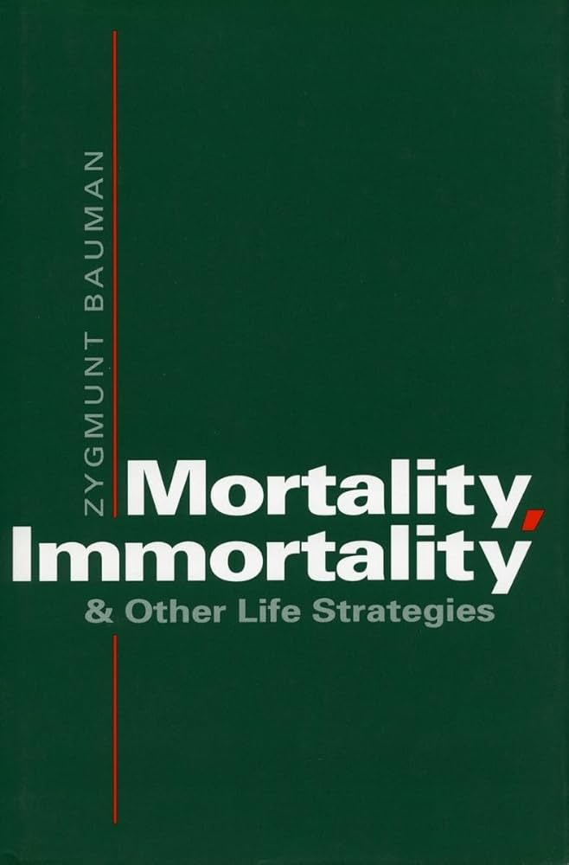
Zygmunt Bauman
(Sociologist and philosopher)
Zygmunt Bauman, Mortality, Immortality, and Other Life Strategies (Stanford: Stanford University Press, 1992), 12, 13.
“There is hardly a thought more offensive than that of death;
or, rather, the inevitability of dying; of the transience of our being in the world…”

Slide 27
Zygmunt Bauman
(Sociologist and philosopher)
Zygmunt Bauman, Mortality, Immortality, and Other Life Strategies (Stanford: Stanford University Press, 1992), 12, 13.
“The horror of death is the horror of the void” and is “bound to remain, traumatic.”

Slide 28
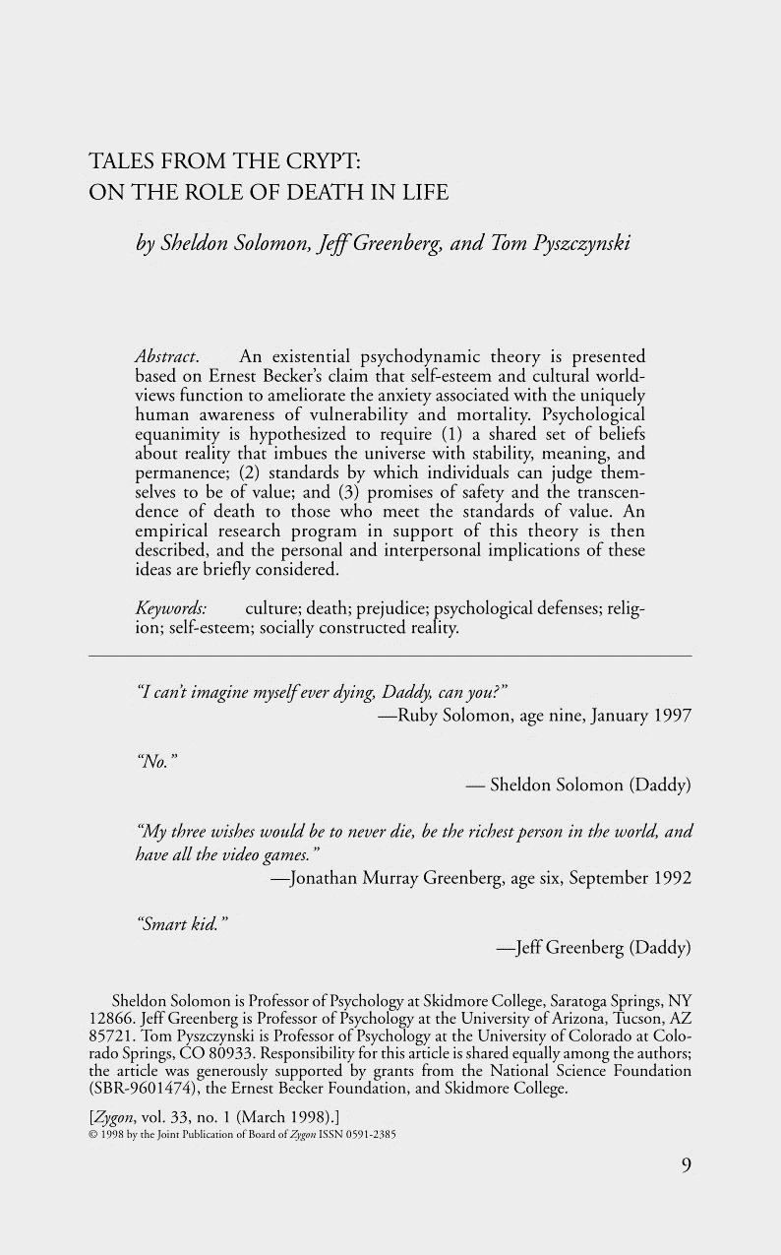
Sheldon Solomon
(Psychology professor at Skidmore College)
Sheldon Solomon, Jeff Greenberg, and Tom Pyszczynski, “Tales from the Crypt: On the Role of Death in Life,” Zygon: Journal of Religion and Science 33, no. 1 (March 1998): 12.
Humans would be riddled with abject terror if they were constantly plagued by the ongoing awareness of their vulnerability and mortality.

Slide 29
Sheldon Solomon
(Psychology professor at Skidmore College)
Sheldon Solomon, Jeff Greenberg, and Tom Pyszczynski, “Tales from the Crypt: On the Role of Death in Life,” Zygon: Journal of Religion and Science 33, no. 1 (March 1998): 12.
Does the Fear of Death lead to Distraction?
#1. Given a flyer to help with “back pain.”
#2. Given a flyer to help with “fear of death.”
“Alcoholic or non-alcoholic beverage?”
Tsachi Ein-Dor et al., “Implicit Death Primes Increase Alcohol Consumption,” Health Psychology 33, no. 7 (2013): 748-51.
[Humans would be] twitching blobs of biological protoplasm completely perfused with anxiety and unable to effectively respond to the demands of their immediate surroundings.

Slide 30
(Heb. 2:14) Only by dying could Jesus break the power of the devil, who had the power of death.
¹⁵ Only in this way could he set free all who have
lived their lives as slaves to the fear of dying.
In the face of certain death, life lacks any objective significance.
Thus, all people fear the horrifying reality of death.
Do we fear death?
“Death anxiety”
“Offensive”
“Horror”
“Traumatic”
“Abject terror”
“Perfused with Anxiety”

Slide 31
In the face of certain death, life lacks any objective significance.
Thus, all people fear the horrifying reality of death.
But the afterlife is real!

Slide 39
If this is all that there is…

Slide 46
But what if this part actually exists??
If this is all that there is…
What if people move…
…from here…
…to here?

Slide 47
This is at the heart of the mission…

