Slide 1
A Simple Solution to a Complex Problem

Slide 2
Our Problem
» Identity Crisis
Achievement

Slide 3
Irv: “You want to know why I cheated.”
Irv: “It’s quite simple really. I had to win.”
“You see, Derice, I’ve made winning my whole life, and when you make winning your whole life, you have to keep winning no matter what.”

Slide 4
Derice: “You had two gold medals. You had it all!”
Irv: “Derice, a gold medal is a wonderful thing…”
Irv: “But if you are not enough without it, you’ll never be enough with it.”
Derice: “Hey Coach, how will I know if I’m enough?”

Slide 5
Our Problem
» Identity Crisis
Achievement
Money
Researchers asked Harvard students to choose between two options (1) Make $90,000 per year while others earn $45,000 or (2) $180,000 a year while others earn $450,000.

Slide 6
Our Problem
» Identity Crisis
Achievement
Money
People find a variety of ways to define themselves.

Slide 7
Our Problem
» Identity Crisis
Human autonomy is the taproot from which all sins originate.
Casting off God’s leadership means bearing the burden of meeting our own needs.
Tim Keller: “The human heart takes good things like a successful career, love, material possessions, even family, and turns them into ultimate things. Our hearts deify them as the center of our lives, because, we think, they can give us significance and security, safety and fulfillment.” ”

Slide 8
God’s Solution
» God solved this complex problem with a simple solution: He’s given us a new identity.
Who you are determines what you do.
“Even before he made the world, God loved us and chose us in Christ to be holy and without fault in his eyes. God decided in advance to adopt us into his own family by bringing us to himself through Jesus Christ” (Ephesians 1:4-5, NLT)

Slide 9
Seeing Ourselves Through God’s Eyes
» Knowing who you are in Christ

Slide 10
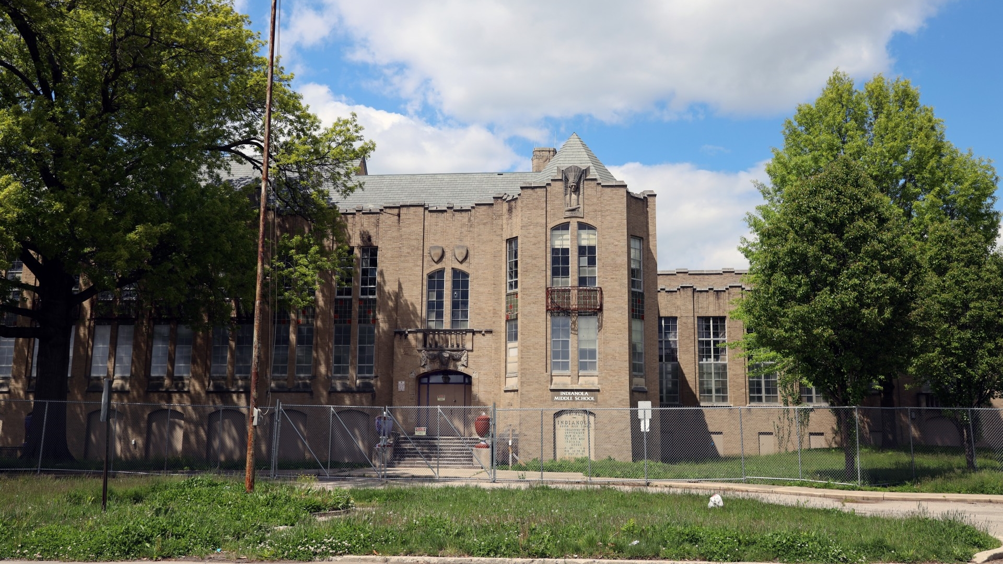

Slide 11
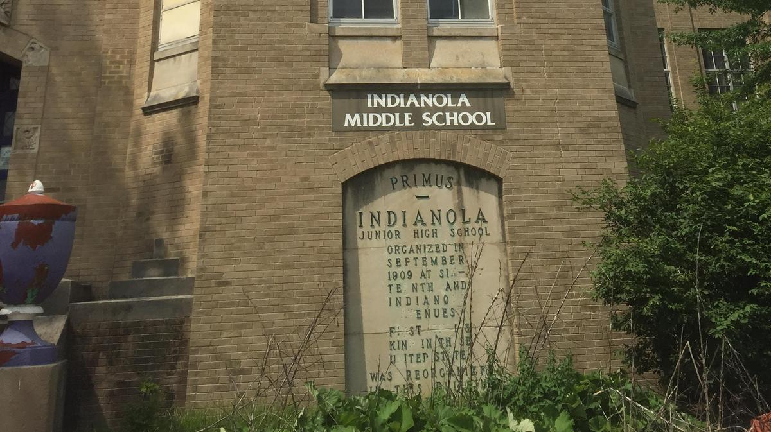

Slide 12
in Christ ∣ in Him
Acts 24:24
Romans 3:24
Romans 6:11
Romans 6:23
Romans 8:1
Romans 8:2
Romans 8:39
Romans 9:1
Romans 12:5
Romans 15:17
Romans 16:3
Romans 16:7
Romans 16:9
1 Corinthians 1:2
1 Corinthians 1:4
1 Corinthians 1:30
1 Corinthians 3:1
1 Corinthians 4:10
1 Corinthians 4:15
1 Corinthians 4:17
1 Corinthians 15:18
1 Corinthians 15:19
1 Corinthians 15:22
1 Corinthians 15:31
1 Corinthians 16:24
2 Corinthians 1:21
2 Corinthians 2:14
2 Corinthians 2:17
2 Corinthians 3:14
2 Corinthians 5:17
2 Corinthians 5:19
2 Corinthians 12:2
2 Corinthians 12:19
Galatians 1:22
Galatians 2:4
Galatians 2:16 *
Galatians 2:16
Galatians 2:17
Galatians 3:24
Galatians 3:26
Galatians 3:28
Galatians 5:6
Galatians 6:15
Ephesians 1:1
Ephesians 1:3
Ephesians 1:4
Ephesians 1:6
Ephesians 1:9
Ephesians 1:10
Ephesians 1:12
Ephesians 1:13
Ephesians 2:6
Ephesians 2:7
Ephesians 2:10
Ephesians 2:13
Ephesians 3:6
Ephesians 3:11
Ephesians 3:21
Ephesians 4:32
Philippians 1:1
Philippians 1:26
Philippians 3:3
Philippians 3:9
Philippians 3:14
Philippians 4:7
Philippians 4:13
Philippians 4:19
Philippians 4:21
Colossians 1:2
Colossians 1:4
Colossians 1:28
Colossians 2:5
Colossians 2:9
Colossians 2:10
Colossians 2:17
1 Thessalonians 2:14
1 Thessalonians 4:16
1 Thessalonians 5:18
1 Timothy 1:14
1 Timothy 3:13
2 Timothy 1:1
2 Timothy 1:9
2 Timothy 1:13
2 Timothy 2:1
2 Timothy 2:10
2 Timothy 3:12
2 Timothy 3:15
Philemon 6
Philemon 8
Philemon 20
Philemon 23
Hebrews 3:14
1 Peter 3:16
1 Peter 5:10
1 Peter 5:14
John 1:4
John 3:15
John 3:16
John 3:18
John 6:40
Acts 17:28
1 Corinthians 1:5
2 Corinthians 1:20
2 Corinthians 13:4
2 Corinthians 5:21
Ephesians 1:4
Ephesians 1:7
Ephesians 1:11
Ephesians 1:13
Ephesians 2:21
Ephesians 2:22
Ephesians 3:12
Philippians 3:9
Colossians 1:6
Colossians 1:7
Colossians 2:3
2 Thessalonians 1:12
1 John 5:14
1 John 5:15
1 John 5:20
1 Peter 1:8
Colossians 2:7
Colossians 2:10
Colossians 2:11
Colossians 2:15
1 John 2:5
1 John 2:6
1 John 2:8
1 John 2:27
1 John 2:28
1 John 3:3
1 John 3:6
1 John 3:24
1 John 4:13
1 John 5:14
1 John 5:15
1 John 5:20
1 Peter 1:8
Matthew 27:42
Colossians 1:14
Colossians 2:3
Ephesians 2:21*
Ephesians 2:21
Ephesians 2:22
Ephesians 3:12
Ephesians 4:21
Galatians 3:22
Revelation 1:9
Galatians 2:16
Romans 3:22
* Indicates multiple uses in one verse

Slide 13
Seeing Ourselves Through God’s Eyes
» Knowing who you are in Christ
• Put into Christ
“Don’t you know that all of us who were baptized into Christ Jesus were baptized into his death?” (Romans 6:3).

Slide 14
Seeing Ourselves Through God’s Eyes
» Knowing who you are in Christ
• Put into Christ
God put you in Christ, and therefore identifies you with him.
“What is true of Christ is also true of us, who are in Christ.”
— Dennis McCallum

Slide 15
Seeing Ourselves Through God’s Eyes
» Knowing who you are in Christ
• Put into Christ
• Scripture uses dozens of metaphors to describe our new identity.

Slide 16
Seeing Ourselves Through God’s Eyes
» What’s our part?
• We need to see ourselves as God sees us.
Scripture urges us to “consider” ourselves dead to sin — our old way of life — and alive to God in Christ Jesus (Romans 6:11).
“Reconcile” a Checkbook

Slide 17
Seeing Ourselves Through God’s Eyes
» What’s our part?
• We also need to come to God as we are in Christ.
God wants us to “present” ourselves to him in our new identity (Romans 6:13).

Slide 18
A Change in Identity a Change in Us
» The security of being loved.
Scripture tells us God created us as dependent beings.
The Fall disrupted this delicate balance.
Our new status in Christ fills the deficit of love we often feel.
“See what great love the Father has lavished on us, that we should be called children of God! And that is what we are!” (1 John 3:1).

Slide 19
A Change in Identity a Change in Us
» The security of being loved.
Scripture tells us God created us as dependent beings.
The Fall disrupted this delicate balance.
Our new status in Christ fills the deficit of love we often feel.
“He who did not spare his own Son, but gave him up for us all—how will he not also, along with him, graciously give us all things”? (Romans 8:32).

Slide 20
A Change in Identity a Change in Us
» The security of being loved.
Scripture tells us God created us as dependent beings.
The Fall disrupted this delicate balance.
Our new status in Christ fills the deficit of love we often feel.
King David: “You created my inmost being; you knit me together in my mother’s womb… Your eyes saw my unformed body; all the days ordained for me were written in your book before one of them came to be…

Slide 21
A Change in Identity a Change in Us
» The security of being loved.
Scripture tells us God created us as dependent beings.
The Fall disrupted this delicate balance.
Our new status in Christ fills the deficit of love we often feel.
King David: “How precious to me are your thoughts, God! How vast is the sum of them! Were I to count them, they would outnumber the grains of sand” (Psalm 139:13, 16-18).

Slide 22
A Change in Identity a Change in Us
» The security of being loved.
Scripture tells us God created us as dependent beings.
The Fall disrupted this delicate balance.
Our new status in Christ fills the deficit of love we often feel.
“For I am convinced that neither death nor life, neither angels nor demons, neither the present nor the future, nor any powers, neither height nor depth…

Slide 23
A Change in Identity a Change in Us
» The security of being loved.
Scripture tells us God created us as dependent beings.
The Fall disrupted this delicate balance.
Our new status in Christ fills the deficit of love we often feel.
“Nor anything else in all creation, will be able to separate us from the love of God that is in Christ Jesus our Lord” (Romans 8:38-39).

Slide 24
A Change in Identity a Change in Us
» The security of being loved.
» The need for significance.
“The ticking clock is loud in both our ears, and it sets us to work.”
— Lin-Manuel Miranda

Slide 25
A Change in Identity a Change in Us
» The security of being loved.
» The need for significance.
• Why did Jesus say that we should become like little children?
Romans 8: “The Spirit himself testifies with our spirit that we are God’s children. Now if we are children, then we are heirs—heirs of God and co-heirs with Christ…For those God foreknew he also predestined to be conformed to the image of his Son, that he might be the firstborn among many brothers and sisters” (16-17, 29).

Slide 26
A Change in Identity a Change in Us
» The security of being loved.
» The need for significance.
• Why did Jesus say that we should become like little children?
Romans 8: “He who did not spare his own Son, but gave him up for us all… (v32).

Slide 27
Toward Lasting Change
» God has met the demands of your need for significance and security in Christ.
» Our new identity is the basis for growth in the Christian life.

