Slide 2
(Jn. 12:12) The next day the
great crowd that had come for
the festival heard that Jesus was on his way to Jerusalem.

Slide 3
(Jn. 12:13) They took palm branches and went out to meet him, shouting,
“Hosanna!”
“Blessed is he who comes in the name of the Lord!”
Palm branches
Nationalistic symbol for the king.
Simon Maccabaeus (1 Maccabees 13:51); cf. 2 Maccabees 10:7; Antiquities 3.245; 13.372
Psalm 118:26
Hosanna (hōsiʿāhna)
“Save, I pray!” or “Salvation now!”
Leon Morris, The Gospel according to John (Grand Rapids, MI: Wm. B. Eerdmans Publishing Co., 1995), p.519.

Slide 4
(Jn. 12:13) They took palm branches and went out to meet him, shouting,
“Hosanna!”
“Blessed is he who comes in the name of the Lord!”
“Blessed is the king of Israel!”

Slide 5
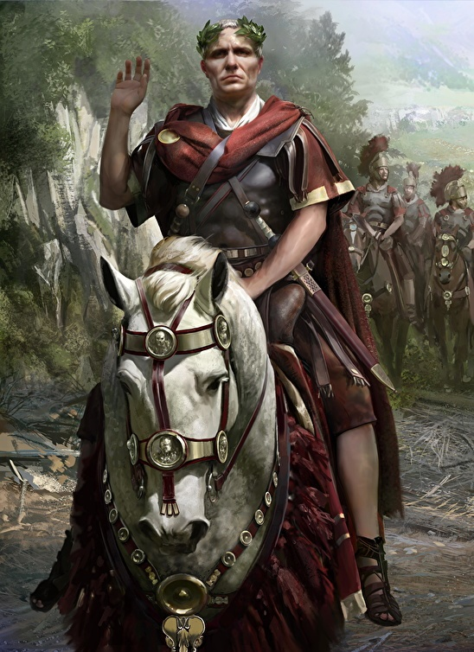
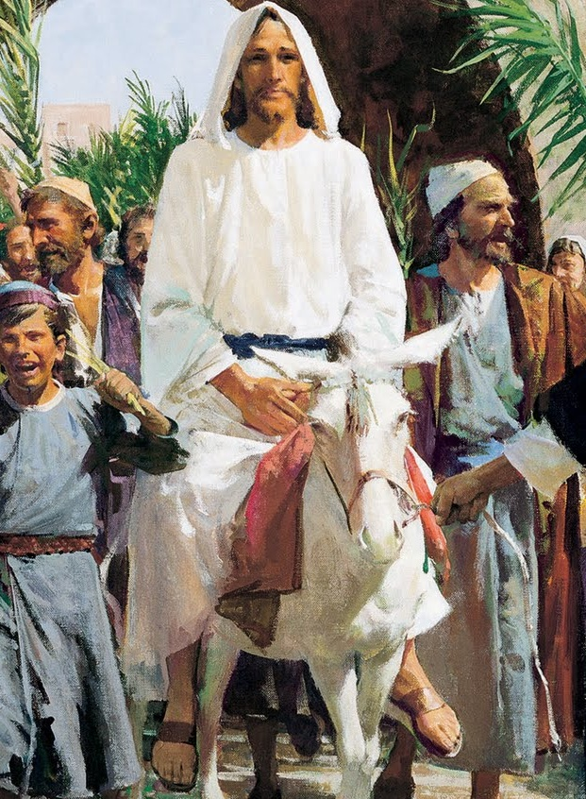
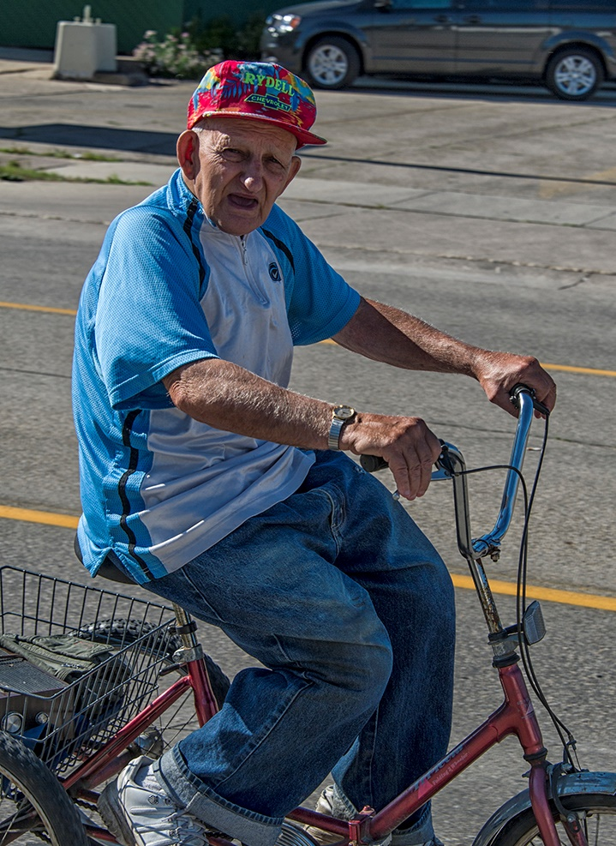
(Jn. 12:14) Jesus found a
young donkey and sat on it.

Slide 6
(Jn. 12:14) Jesus found a
young donkey and sat on it.
As it is written:
¹⁵ “Do not be afraid, Daughter Zion. See, your king is coming, seated on a donkey’s colt.”
Zechariah 9:9

Slide 7
(Jn. 12:23) Jesus said,
“The hour has come for the Son of Man to be glorified.”

Slide 8
(Jn. 12:23) Jesus said,
“The hour has come for the Son of Man to be glorified.”
“The King of Israel” (v.13)
Rode a donkey—not a stallion.
Verse 14
Had a “great crowd” that dwindled to nearly nothing.
Verses 12 and 17
“Glorified” through being crucified.
Verse 16
Liberated people from spiritual oppression—not political oppression.

Slide 9
(Jn. 12:23) Jesus replied,
“The hour has come for the Son of Man to be glorified.”
If Jesus was a humble leader,
then how should followers of Jesus live?

Slide 10
(Jn. 12:24) “Very truly I tell you, unless a kernel of wheat falls to the ground and dies, it remains only a single seed. But if it dies, it produces many seeds.”
There’s only one way for a seed to bear fruit:
It needs to be broken open.

Slide 11
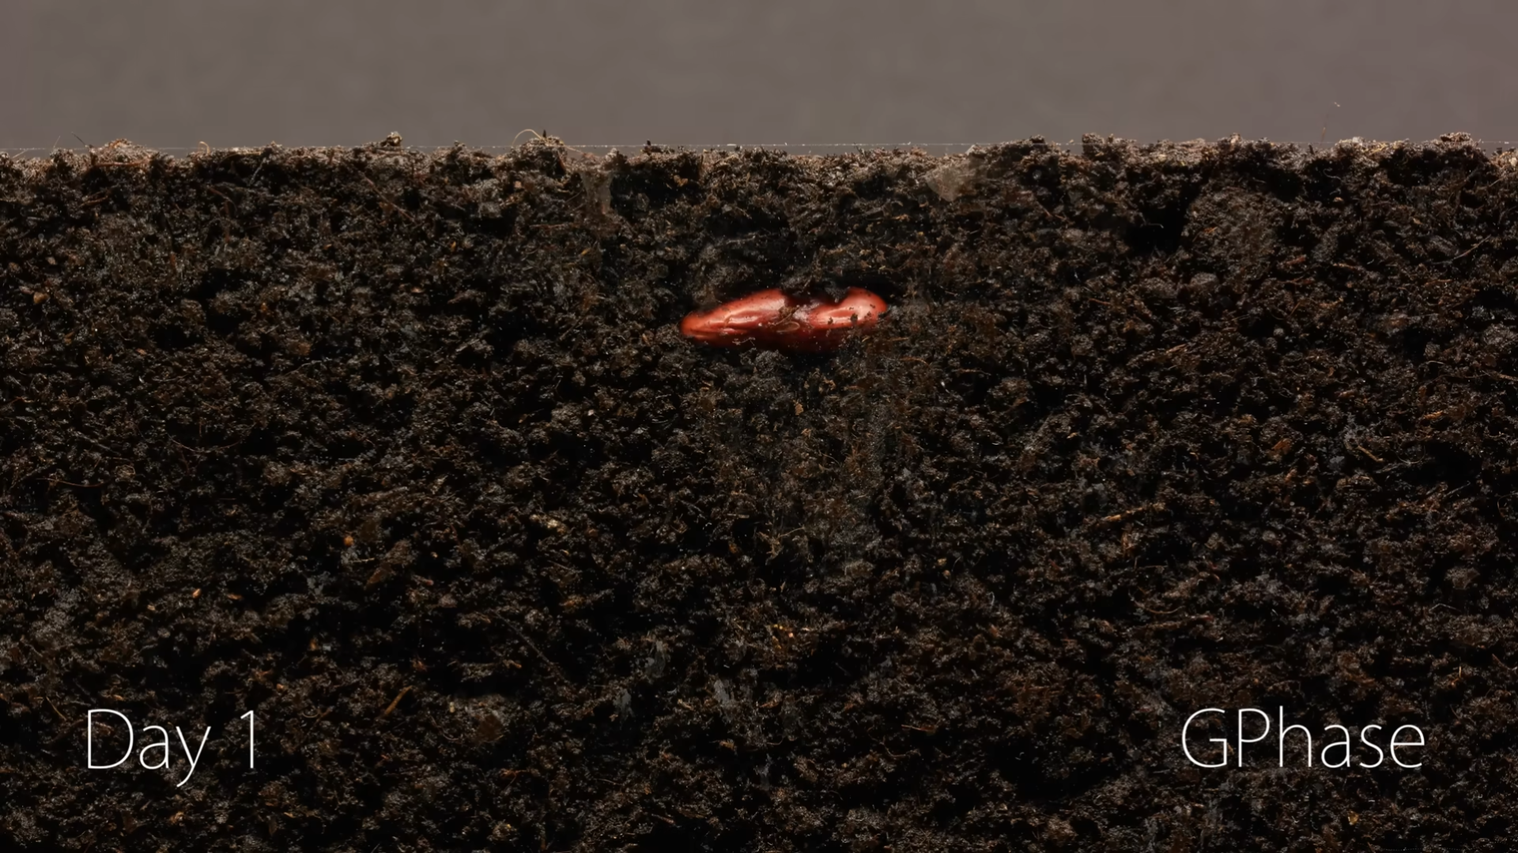

Slide 12
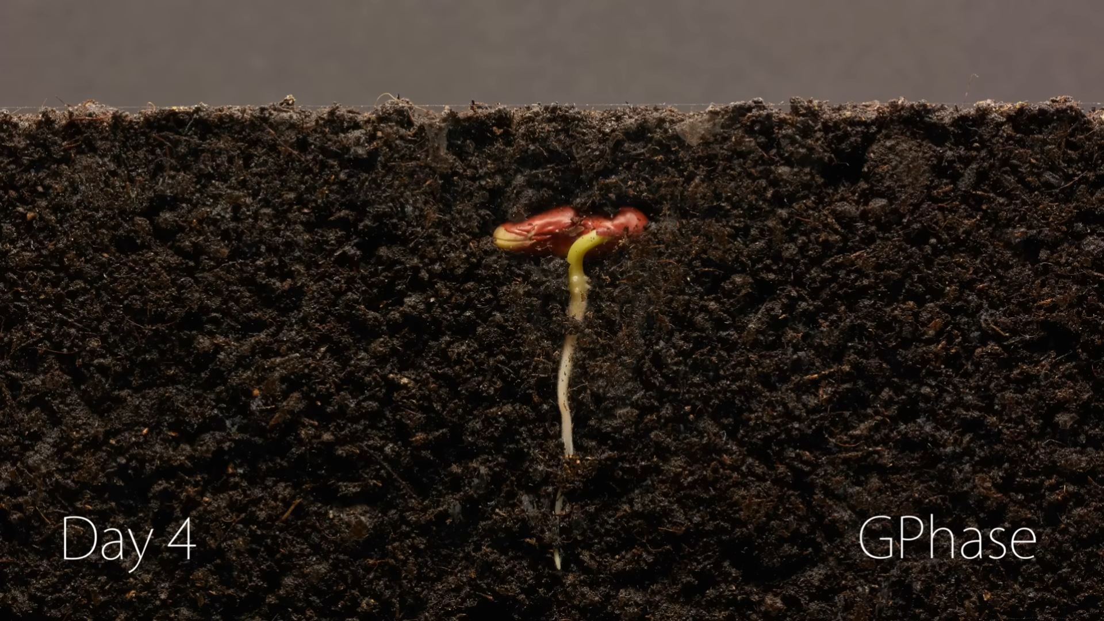

Slide 13
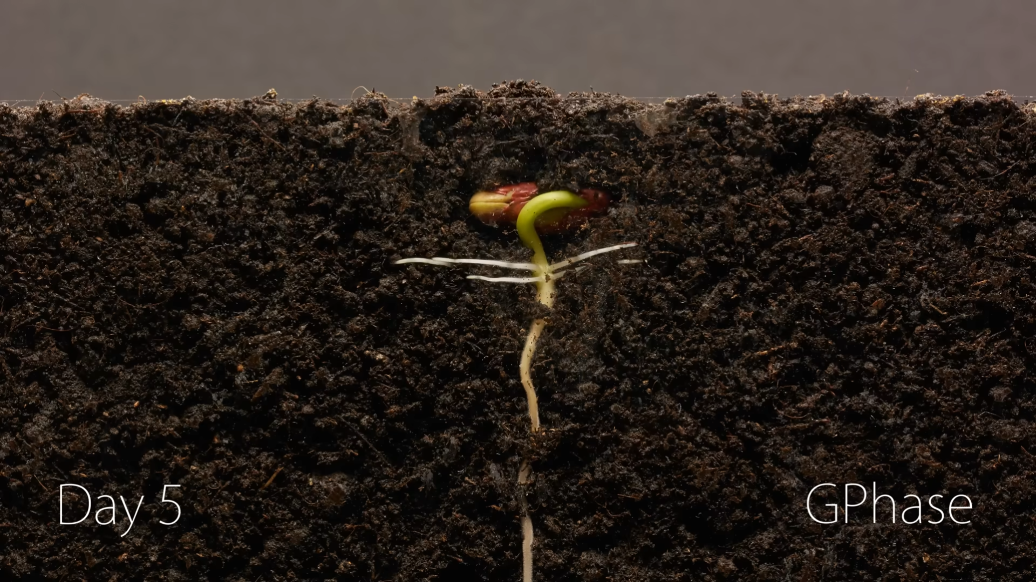

Slide 14
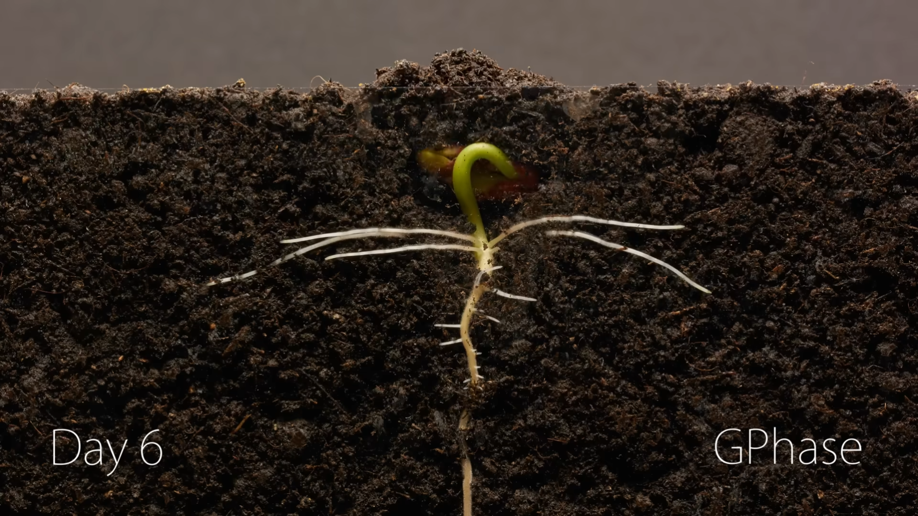

Slide 15
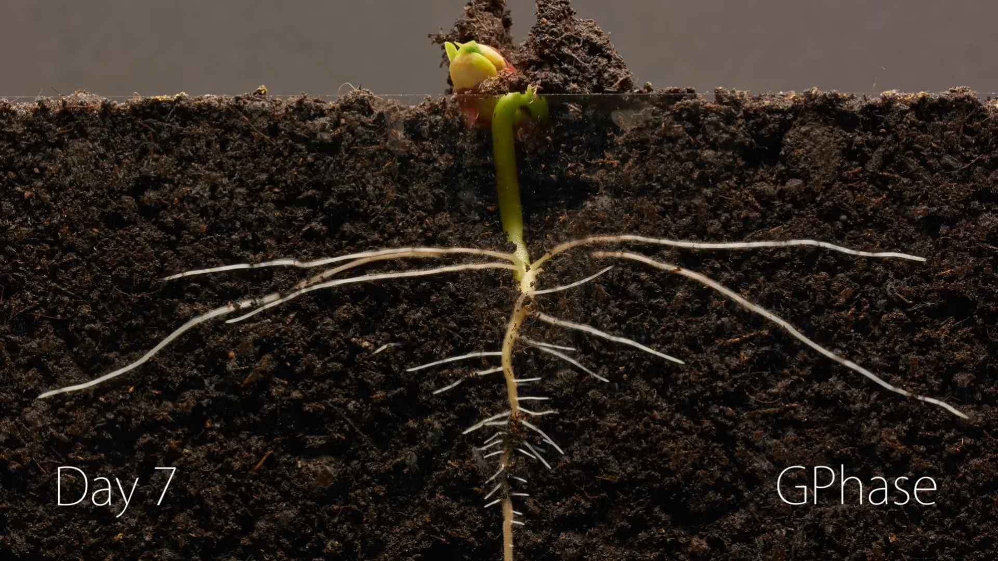

Slide 16
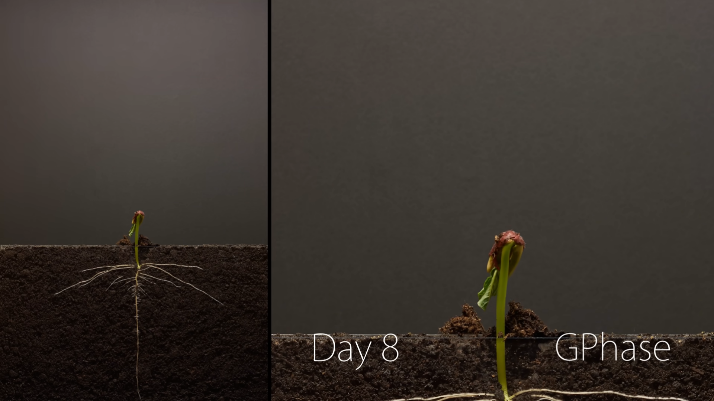

Slide 17
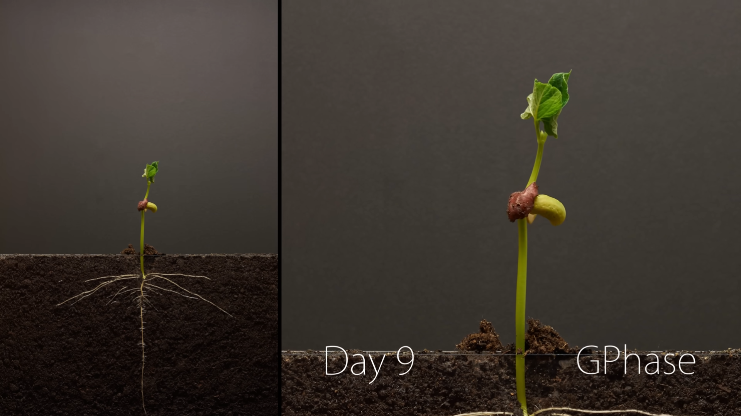

Slide 18
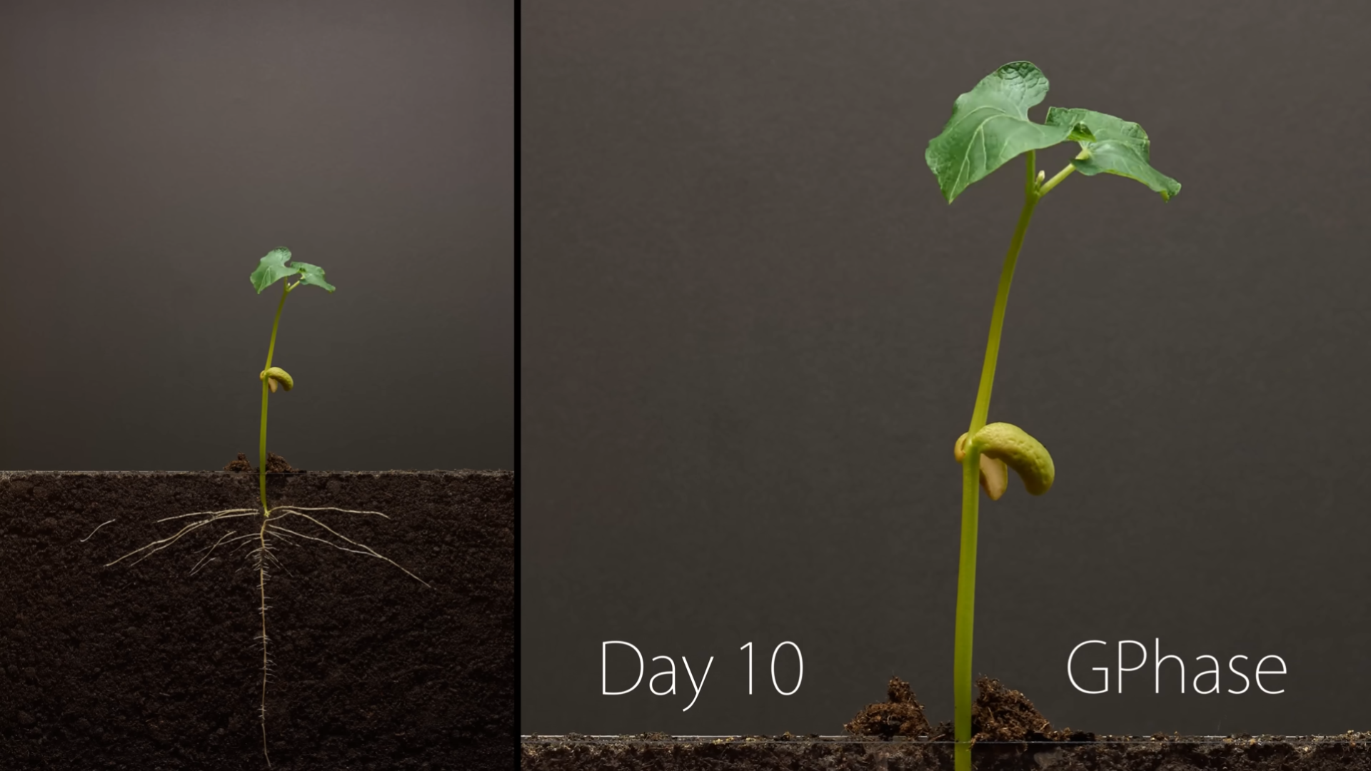

Slide 19
(Jn. 12:24) “Very truly I tell you, unless a kernel of wheat falls to the ground and dies, it remains only a single seed. But if it dies, it produces many seeds.”
(2 Cor. 4:6) God has made this light shine in our hearts so we could know the glory of God…
⁷ We now have this light shining in our hearts, but we ourselves are like fragile clay jars containing this great treasure.
This makes it clear that our great power is from God, not from ourselves.
There’s only one way for a seed to bear fruit:
It needs to be broken open.

Slide 22
“My car broke down.”
“I lost my job.”
“I overdrafted on my bank account.”

Slide 23
“My car broke down.”
“I lost my job.”
“I overdrafted on my bank account.”

Slide 24
“My roommates irritate me.”
“People insult me for my faith.”
“I keep failing in my efforts.”

Slide 25
“My roommates irritate me.”
“People insult me for my faith.”
“I keep failing in my efforts.”

Slide 26
“I’d like to take a step of faith and impact others for Christ.”

Slide 27
“I’d like to take a step of faith and impact others for Christ.”

Slide 28
“I want to get married!”

Slide 39
Watchman Nee
(Christian Leader & Author, 1903-1972)
Watchman Nee, The Release of the Spirit (Sure Foundation Publishers, 1965), 9-10.
As we shall see, there is just one basic dealing which can enable man to be useful before God:
brokenness.

Slide 40
Watchman Nee
(Christian Leader & Author, 1903-1972)
Watchman Nee, The Release of the Spirit (Sure Foundation Publishers, 1965), 14.
To some, the Lord gives a sudden breaking followed by a gradual one.
With others, the Lord arranges that they have constant daily trials, until one day He brings about large-scale breaking.

Slide 41
Watchman Nee
(Christian Leader & Author, 1903-1972)
Watchman Nee, The Release of the Spirit (Sure Foundation Publishers, 1965), 14.
The timing is in His hand.
We cannot shorten the time,
though we certainly can prolong it.

Slide 42
Watchman Nee
(Christian Leader & Author, 1903-1972)
Watchman Nee, The Release of the Spirit (Sure Foundation Publishers, 1965), 37.
How often our prayers for blessings are actually raising up barriers.
We long for blessing, yet seem to find God’s mercy in crushing experiences.

Slide 43
Watchman Nee
(Christian Leader & Author, 1903-1972)
Watchman Nee, The Release of the Spirit (Sure Foundation Publishers, 1965), 81.
How often when the Lord deals with us we see only the hand of man.
This is entirely wrong.
We must remember that it is God who is dealing with us, not our brother or sister or any other person.

Slide 44
Watchman Nee
(Christian Leader & Author, 1903-1972)
Watchman Nee, The Release of the Spirit (Sure Foundation Publishers, 1965), 81.
Has the Lord for years disciplined us,
but instead of recognizing His hand
we blamed it on other people
or on fate?

Slide 45
Watchman Nee
(Christian Leader & Author, 1903-1972)
Watchman Nee, The Release of the Spirit (Sure Foundation Publishers, 1965), 81.
Oh, may we have the grace to recognize the meaning of His hand in seeking to shatter this outward man!

Slide 46
(Jn. 12:24) “Very truly I tell you, unless a kernel of wheat falls to the ground and dies, it remains only a single seed. But if it dies, it produces many seeds.”

Slide 47
(Jn. 12:24) “Very truly I tell you, unless a kernel of wheat falls to the ground and dies, it remains only a single seed. But if it dies, it produces many seeds.”
²⁵ “Anyone who loves their life will lose it, while anyone who hates their life in this world will keep it for eternal life.”

Slide 48
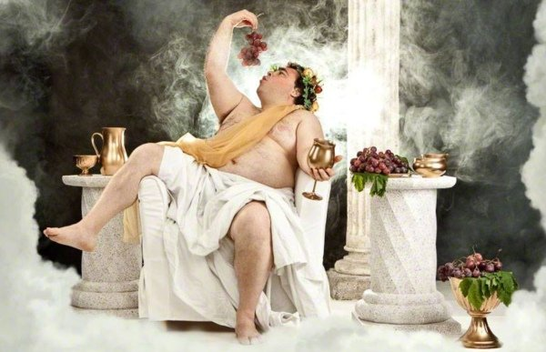
(Jn. 12:24) “Very truly I tell you, unless a kernel of wheat falls to the ground and dies, it remains only a single seed. But if it dies, it produces many seeds.”
²⁵ “Anyone who loves their life will lose it, while anyone who hates their life in this world will keep it for eternal life.”
How much do you love yourself?
Thought life?
Screen time?
Sleep?
Spending?
Quick to quit?

Slide 49
(Jn. 12:26) “Whoever serves me must follow me. Where I am, my servant also will be. My Father will honor the one who serves me.”

Slide 50
(Jn. 12:27) “Now my soul is troubled, and what shall I say?
‘Father, save me from this hour’?
No, it was for this very reason I came to this hour.”
²⁸ Father, glorify your name!”

Slide 51
(Jn. 12:27) “Now my soul is troubled, and what shall I say?
‘Father, save me from this hour’?
No, it was for this very reason I came to this hour.”
²⁸ Father, glorify your name!”
No need to hide our feelings from God!

Slide 52
(Jn. 12:27) “Now my soul is troubled, and what shall I say?
‘Father, save me from this hour’?
No, it was for this very reason I came to this hour.”
²⁸ Father, glorify your name!”
No need to bottle up our thought process with God.

Slide 53
(Jn. 12:27) “Now my soul is troubled, and what shall I say?
‘Father, save me from this hour’?
No, it was for this very reason I came to this hour.”
²⁸ Father, glorify your name!”
Committing to doing what is true and right—despite the risks or the pain.

Slide 54
(Jn. 12:27) “Now my soul is troubled, and what shall I say?
‘Father, save me from this hour’?
No, it was for this very reason I came to this hour.”
²⁸ Father, glorify your name!”
This is a prayer that God will always answer! (1 Jn. 5:14-15)

Slide 55
(Jn. 12:28) Then a voice came from heaven, “I have glorified it, and will glorify it again.”

Slide 56
(Jn. 12:32) Jesus said,
“I, when I am lifted up from the earth, will draw all people to myself.”
³³ He said this to show the kind of death he was going to die.

Slide 57
(Jn. 12:35) Then Jesus told them,
“You are going to have the light just a little while longer. Walk while you have the light, before darkness overtakes you.
Whoever walks in the dark does not know where they are going.”

Slide 58
(Jn. 12:36) “Believe in the light while you have the light, so that you may become children of light.”

