Slide 1
A Wind in the House of Islam Muslim Movements to Christ
David Garrison
Dwell Community Church 2024

Slide 2
A Little Background

Slide 3
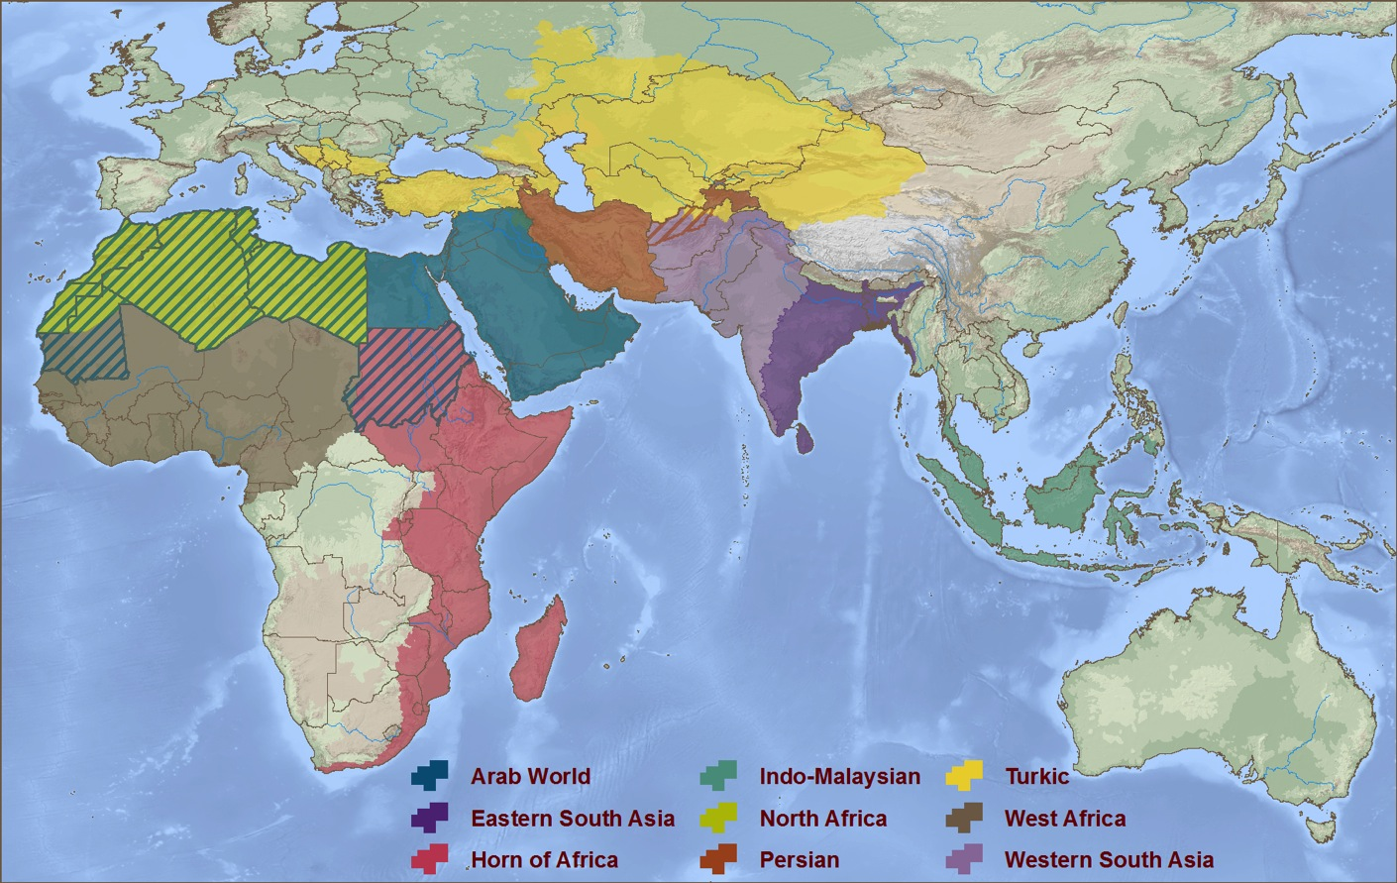
Nine Rooms in the House of Islam
Nine Distinct Cultural Zones
Turkestan
Persian
World
Western
South Asia
North Africa
Arab World
Eastern
South Asia
West Africa
East Africa
Indo-Malaysia
© 2024 WIGTake Resources
www.WindintheHouse.org

Slide 4
For Fourteen Centuries Islam Has Expanded
Drawing Millions of Christians into the House of Islam
© 2013 WIGTake Resources
www.WindintheHouse.org

Slide 5
Islamic Expansion AD 622
Year of the Hijra, Muhammad’s escape to Medina
The Muslim calendar begins with Muhammad’s escape from Mecca to Medina
© 2024 WIGTake Resources
www.WindintheHouse.org

Slide 6
Islamic Expansion AD 630
Muhammad’s returns to conquer Mecca
© 2024 WIGTake Resources
www.WindintheHouse.org

Slide 7
Islamic Expansion AD 632
The year of Muhammad’s death
632 Muhammad dies
© 2024 WIGTake Resources
www.WindintheHouse.org

Slide 8
Islamic Expansion AD 634
Conquest of the Arabian Peninsula
© 2024 WIGTake Resources
www.WindintheHouse.org

Slide 9
Islamic Expansion AD 656
Defeat of Byzantine and Persian armies
636 Damascus falls
637 Jerusalem falls
651 Persia’s Sassanian Dynasty falls
642 Conquest of Egypt
© 2024 WIGTake Resources
www.WindintheHouse.org

Slide 10
Islamic Expansion AD 732
One hundred years after Muhammad’s death
732 Islam stopped at Tours
Islam sweeps across North Africa into Spain
© 2024 WIGTake Resources
www.WindintheHouse.org

Slide 11
Islamic Expansion AD 1250 - 1400
By 1267 Islam stretches from the Atlantic to the Pacific
1267 first Islamic kingdom established in Indonesia
© 2024 WIGTake Resources
www.WindintheHouse.org

Slide 12
Islamic Expansion 1400 - 1600
Geographic zenith of Islamic expansion
1529 Siege of Vienna
Golden Horde dominates Central Asia
1453 fall of Constantinople
1526 Mughal Empire established in India
© 2024 WIGTake Resources
www.WindintheHouse.org

Slide 13
Islamic Expansion 17th – 21st Centuries
The modern era – Muslim population explosion
Population stress pushes Muslim emigrants around the world
Islam continues to be the world’s fastest growing religion at 1.84% per year
2024 global Muslim population reaches 1.8 billion
© 2024 WIGTake Resources
www.WindintheHouse.org

Slide 14
Fourteen Centuries of Islamic Expansion
Tens of millions of Christians assimilated into Islam
© 2024 WIGTake Resources
www.WindintheHouse.org

Slide 15
But What About the Opposite?
Have there ever been Muslim movements to Christ?
If so, where, when and how?
© 2024 WIGTake Resources
www.WindintheHouse.org

Slide 16
Fourteen Centuries of Islamic Expansion
Tens of millions of Christians assimilated into Islam
© 2024 WIGTake Resources
www.WindintheHouse.org

Slide 17
But What About the Opposite?
Have there ever been Muslim movements to Christ?
If so, where, when and how?
© 2024 WIGTake Resources
www.WindintheHouse.org

Slide 18
A Wind in the House of Islam
Largest global survey of Muslim movements to Christ ever conducted
Traveled 250,000 miles
Gathered more than 1,000 interviews from movements
Central question: What did God use to bring you to faith in Jesus Christ? Tell me your story.

Slide 19
Muslim Movements to Christ through the Centuries

Slide 20
What is happening now?
Ten facts regarding Muslim movements to Christ
© 2024 WIGTake Resources
www.WindintheHouse.org

Slide 21
Ten Facts regarding Muslim Movements to Christ
1. We are today witnessing the greatest turning of Muslims to Christ in history
2. This continues to be a very costly ministry
3. Scripture engagement has been crucial to movements
4. Media has been a game changer
5. The global diaspora are a gift from God

Slide 22
Ten Facts regarding Muslim Movements to Christ
6. Dreams and visions are evidence of the Paraclete promise
7. Dreams and visions are not enough
8. Muslims are not evil
9. God can hit straight with a “crooked stick”
10. New breakthroughs are on the horizon!

Slide 23
www.WindintheHouse.org
© 2013 WIGTake Resources
www.WindintheHouse.org

