Slide 1
2 Tim 4:1-5

Slide 2
2 Timothy 4:1–5 (NASB95)
1 I solemnly charge you in the presence of God and of Christ Jesus, who is to judge the living and the dead, and by His appearing and His kingdom: 2 preach the word; be ready in season and out of season; reprove, rebuke, exhort, with great patience and instruction.

Slide 3
The wind up
“In the presence of God and Christ Jesus”
The invocation of divine witness
Of the utmost importance according to the highest authority

Slide 4
The wind up
“Who judges the living and the dead”
The eternal consequences of the issue at hand

Slide 5
The wind up
“In view of His appearing and His kingdom”
Remember the boss is coming back!

Slide 6
The wind up
“With all of heaven watching, and with eternity in mind, here’s what you must do.”

Slide 7
The command
2 preach the word;
33.256 κηρύσσω^{c} kērussō : to publicly announce religious truths and principles while urging acceptance and compliance—‘to preach
Louw, J. P., & Nida, E. A. (1996). In Greek-English lexicon of the New Testament: based on semantic domains (electronic ed. of the 2nd edition., Vol. 1, p. 416). United Bible Societies.
As HC leaders we are the keepers of this solemn charge

Slide 8
The command
2 preach the word;
Leaders are charged to be the guardians of the content proclaimed to their flock

Slide 9
Guardians of content
Of course this means theological correctness
“We are not called to proclaim philosophy and metaphysics, but the simple gospel. Man's fall, his need of a new birth, forgiveness through an atonement, and salvation as the result of faith—these are our battle-axe and weapons of war.” -Spurgeon

Slide 10
Guardians of content
Of course this means theological correctness
“We are not called to proclaim philosophy and metaphysics, but the simple gospel. Man's fall, his need of a new birth, forgiveness through an atonement, and salvation as the result of faith—these are our battle-axe and weapons of war.” -Spurgeon

Slide 11
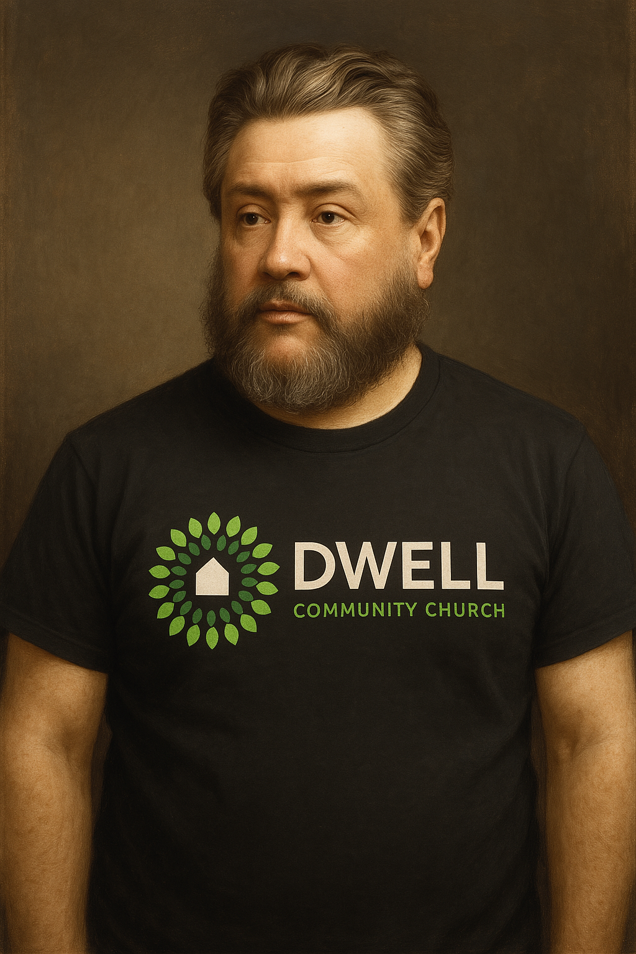
Guardians of content
Of course this means theological correctness
“We are not called to proclaim philosophy and metaphysics, but the simple gospel. Man's fall, his need of a new birth, forgiveness through an atonement, and salvation as the result of faith—these are our battle-axe and weapons of war.” -Spurgeon

Slide 12
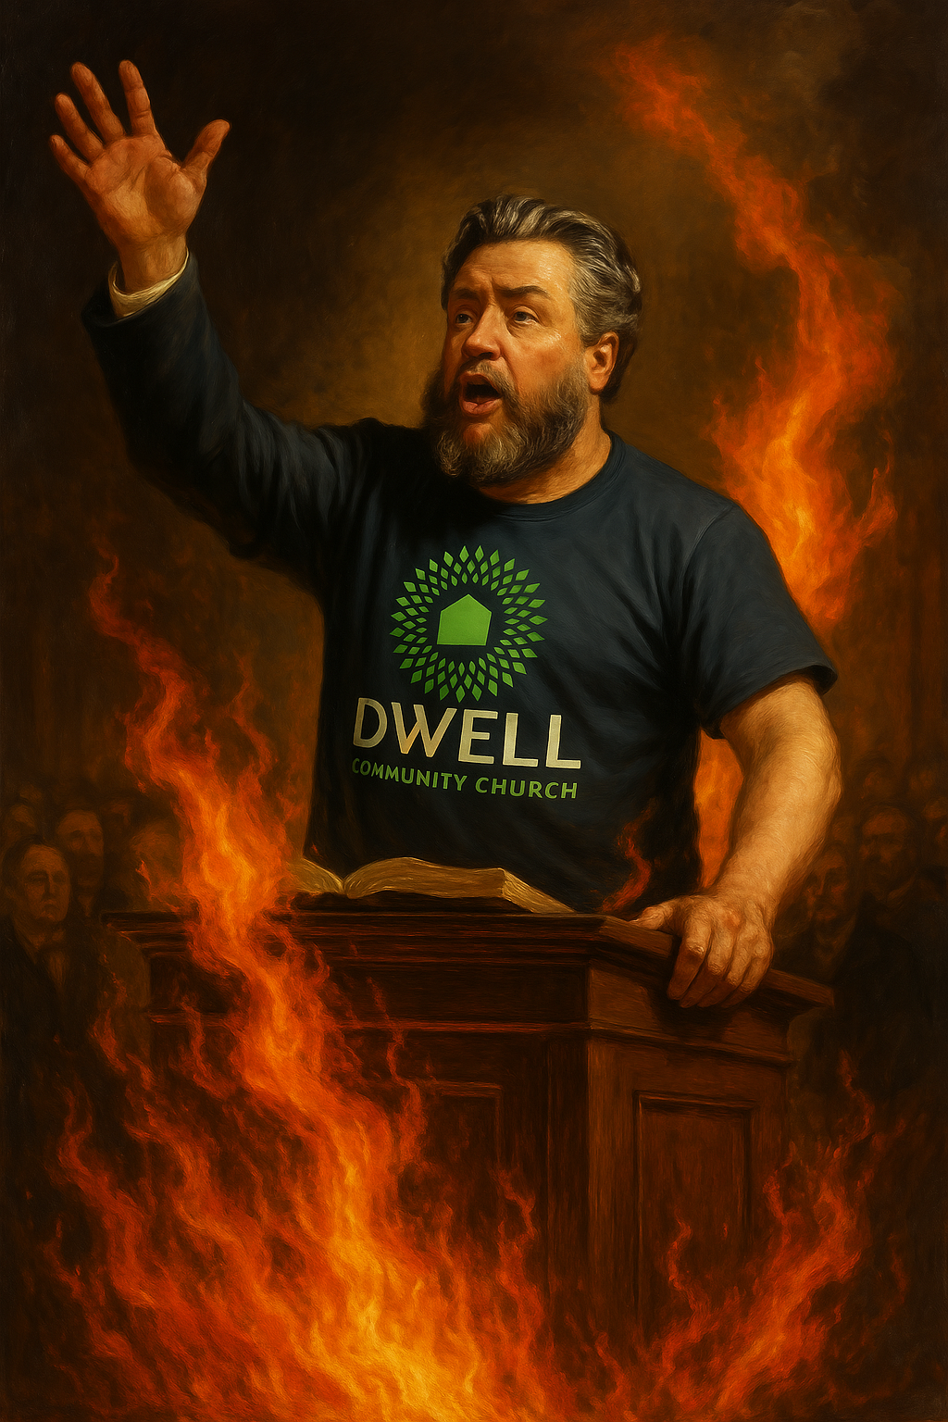
Guardians of content
Of course this means theological correctness
“We are not called to proclaim philosophy and metaphysics, but the simple gospel. Man's fall, his need of a new birth, forgiveness through an atonement, and salvation as the result of faith—these are our battle-axe and weapons of war.” -Spurgeon

Slide 13
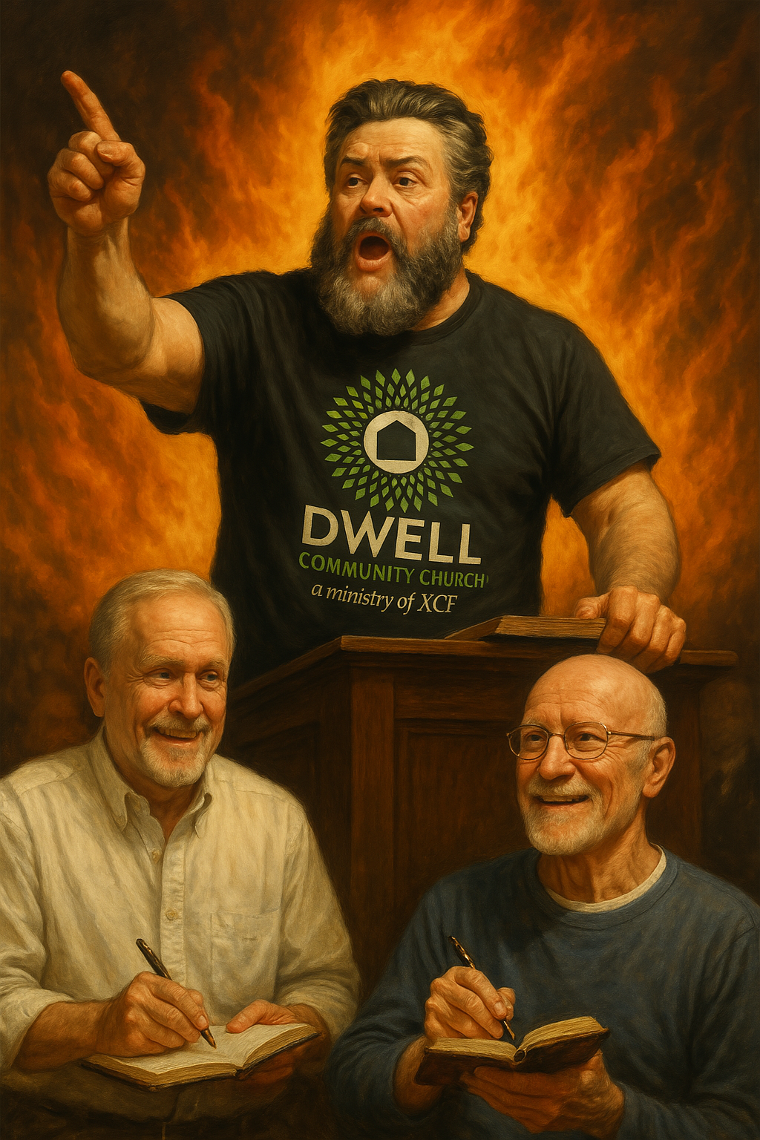
Guardians of content
Of course this means theological correctness
“We are not called to proclaim philosophy and metaphysics, but the simple gospel. Man's fall, his need of a new birth, forgiveness through an atonement, and salvation as the result of faith—these are our battle-axe and weapons of war.” -Spurgeon

Slide 14
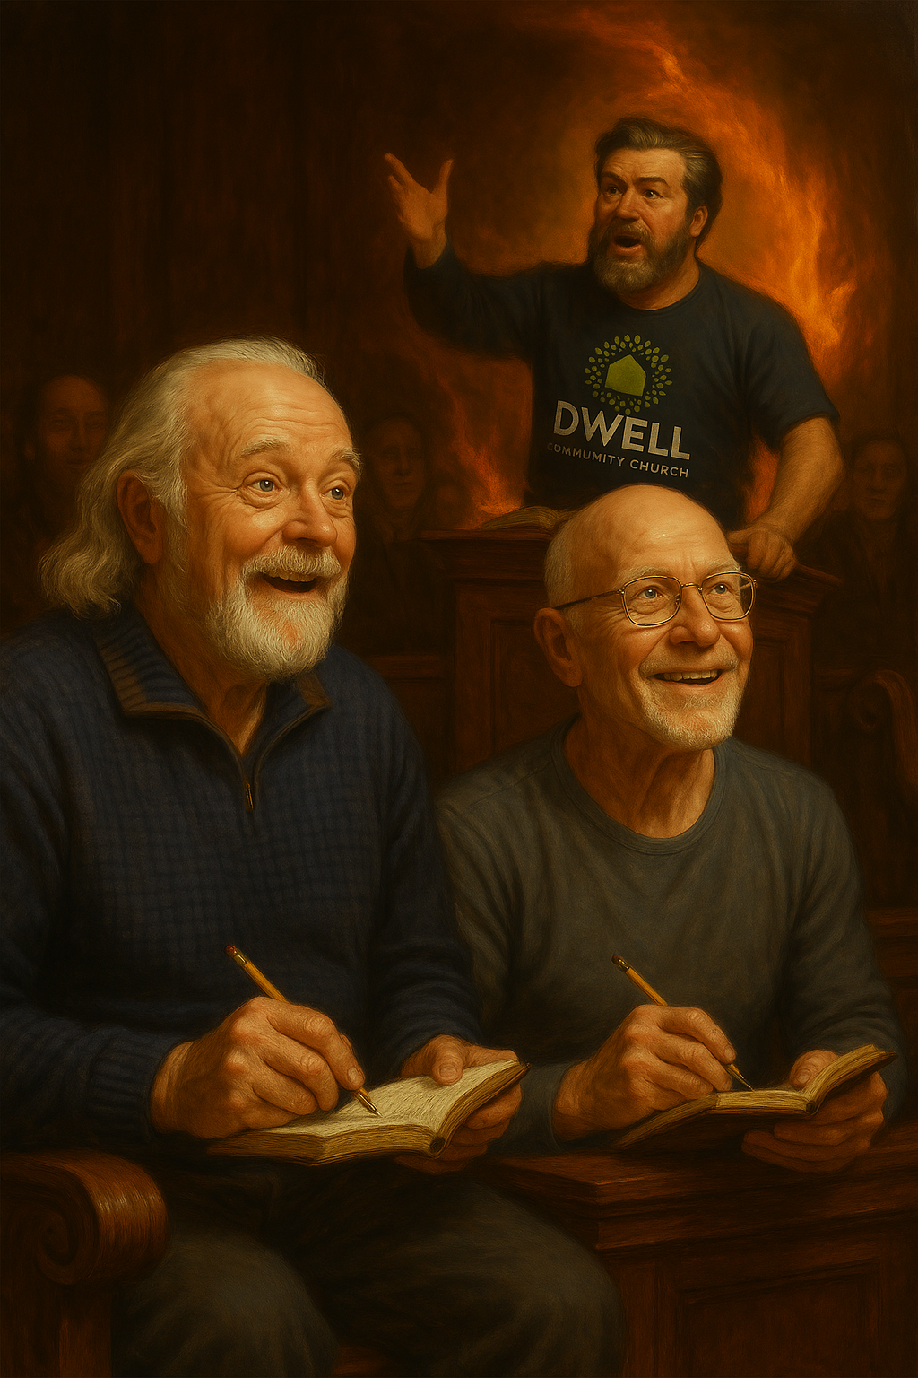
Guardians of content
Of course this means theological correctness
“We are not called to proclaim philosophy and metaphysics, but the simple gospel. Man's fall, his need of a new birth, forgiveness through an atonement, and salvation as the result of faith—these are our battle-axe and weapons of war.” -Spurgeon

Slide 15
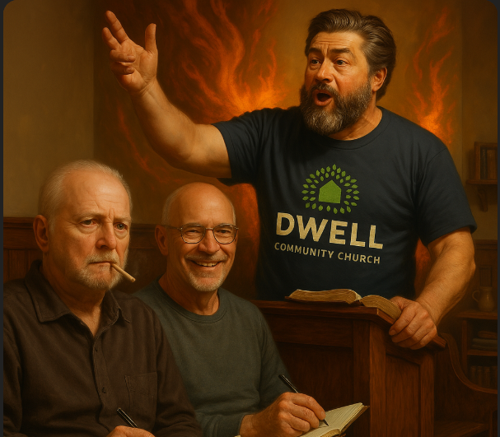
Guardians of content
Of course this means theological correctness
“We are not called to proclaim philosophy and metaphysics, but the simple gospel. Man's fall, his need of a new birth, forgiveness through an atonement, and salvation as the result of faith—these are our battle-axe and weapons of war.” -Spurgeon

Slide 16
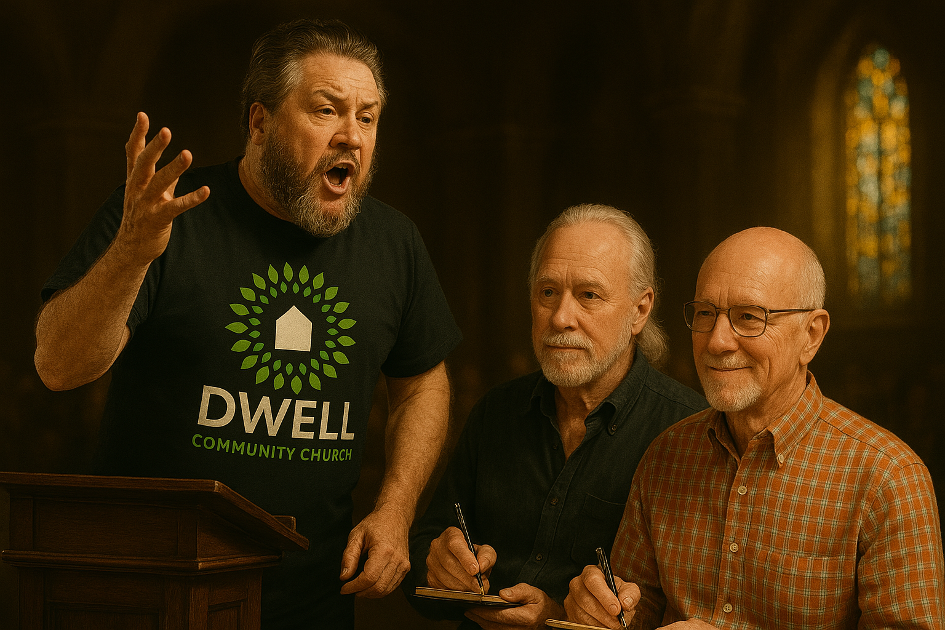
Guardians of content
Of course this means theological correctness
“We are not called to proclaim philosophy and metaphysics, but the simple gospel. Man's fall, his need of a new birth, forgiveness through an atonement, and salvation as the result of faith—these are our battle-axe and weapons of war.” -Spurgeon

Slide 17
Guardians of content
Of course this means theological correctness
“We are not called to proclaim philosophy and metaphysics, but the simple gospel. Man's fall, his need of a new birth, forgiveness through an atonement, and salvation as the result of faith—these are our battle-axe and weapons of war.” -Spurgeon
Ryan’s teaching prep process
-Unmedicated ADD

Slide 18
Guardians of content
Of course this means theological correctness
“We are not called to proclaim philosophy and metaphysics, but the simple gospel. Man's fall, his need of a new birth, forgiveness through an atonement, and salvation as the result of faith—these are our battle-axe and weapons of war.” -Spurgeon

Slide 19
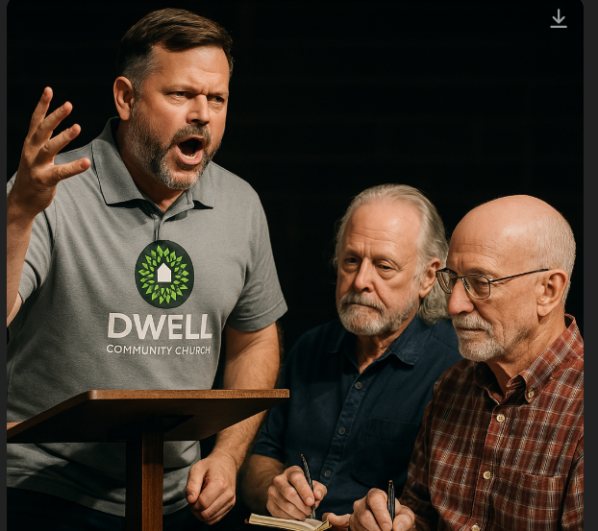
Guardians of content
Of course this means theological correctness
“We are not called to proclaim philosophy and metaphysics, but the simple gospel. Man's fall, his need of a new birth, forgiveness through an atonement, and salvation as the result of faith—these are our battle-axe and weapons of war.” -Spurgeon

Slide 20
Guardians of content
Of course this means theological correctness
“We are not called to proclaim philosophy and metaphysics, but the simple gospel. Man's fall, his need of a new birth, forgiveness through an atonement, and salvation as the result of faith—these are our battle-axe and weapons of war.” -Spurgeon

Slide 21
Guardians of content
Of course this means theological correctness
“We are not called to proclaim philosophy and metaphysics, but the simple gospel. Man's fall, his need of a new birth, forgiveness through an atonement, and salvation as the result of faith—these are our battle-axe and weapons of war.” -Spurgeon

Slide 22
Guardians of content
Of course this means theological correctness
“We are not called to proclaim philosophy and metaphysics, but the simple gospel. Man's fall, his need of a new birth, forgiveness through an atonement, and salvation as the result of faith—these are our battle-axe and weapons of war.” -Spurgeon

Slide 23
Guardians of content
Of course this means theological correctness
“We are not called to proclaim philosophy and metaphysics, but the simple gospel. Man's fall, his need of a new birth, forgiveness through an atonement, and salvation as the result of faith—these are our battle-axe and weapons of war.” -Spurgeon

Slide 24
Guardians of content
Of course this means theological correctness
Holding the word of God in high esteem

Slide 25
Guardians of content
The quality and impact of the teaching
“I do not think the devil cares how many churches you build, if only you have lukewarm preachers in them.” -Spurgeon

Slide 26
Guardians of content
We are charged in a solemn way to make sure our HC teachings are good
“The preaching of Christ is the whip that flogs the devil. It is the thunderbolt, the sound of which makes all hell shake.”-Spurgeon

Slide 27
Guardians of content
How many people are on your teaching rotation?
6?
8?
12?

Slide 28
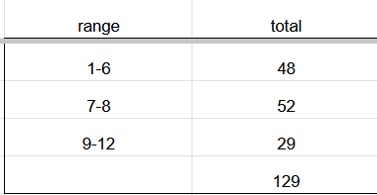
Guardians of content
How many people are on your teaching rotation?
6?
8?
12?

Slide 29
Guardians of content
What determines who should be on the teaching rotation?
Character?
Discipleship?
Gifting?
Role?

Slide 30
Guardians of content
The concern I have
More people means less work
Bad teachers get put up because we don’t like conflict
ALL leaders should teach equal numbers of times
We don’t give each other teaching feedback

Slide 31
Guardians of content
Why does this matter?
It matters to God
It is explicit from Paul to Timothy
It is one of the fastest ways to render your group toothless

Slide 32
Guardians of content
It’s amazing how believers will endure bad teaching
“The Smelly Dog”

Slide 33
Guardians of content
Non-believers will not endure this
One bad night can undue months or years of work
frequent bad nights will kill evangelism completely

Slide 34
Getting Practical (advice)
1) Only have your best teachers (top 6) teach frequently.
Best 2 every 4-6 weeks
Next best 2 ever 6-8 weeks
Next best 2 once a quarter
New teachers 1 a quarter

Slide 35
Getting Practical (advice)
Only have your best teachers (top 6) teach frequently.
Best 2 every 4-6 weeks
Next best 2 ever 6-8 weeks
Next best 2 once a quarter
New teachers 1 a quarter
19 teachings
-Top 4 teachers cover 14/19
-Even your best teachers only teaching less than 1 a month

Slide 36
Getting Practical (advice)
Who decides who is best?
If we can’t have honest discussions about this, how do we talk about, porn, money, parenting, marriage etc.?
Regular teacher feedback
Anonymous survey of your leadership team
Ask a coach

Slide 37
Getting Practical (advice)
Who decides who is best?
A good rule of thumb
The ONLY people on your regular rotation should be people who you would glad to have your non-believing friends come and hear.

Slide 38
Getting Practical (advice)
Cell group is a different matter
Teaching quality matters there too
Non-believers typically not present
More discussion oriented
STILL IMPORTANT
Better grounds for getting reps and improvement

Slide 39
Getting Practical (advice)
We don’t have 6 teachers I would want my non-Christian friends to hear!
Bring your guests to CT before HC
Work with a HC coach

Slide 40
Getting Practical (advice)
Shouldn’t every leader teach HC?
Isn’t it a requirement for deacons to be able to teach the word?

Slide 41
Getting Practical (advice)
Shouldn’t every leader teach HC?
Isn’t it a requirement for deacons to be able to teach the word?
1 Timothy 3:1–2 (NIV) — 1 Here is a trustworthy saying: Whoever aspires to be an overseer desires a noble task. 2 Now the overseer is to be above reproach, faithful to his wife, temperate, self-controlled, respectable, hospitable, able to teach,

Slide 42
Getting Practical
You can be a FULLY engaged awesome HC leader and not teach HC.
Good I want out!
The needs of the group
Discuss with your team

Slide 43
Getting Practical
2) How to improve
Take Homiletics class
Take Teaching group discussion class
ASK for feedback
Work with a good teacher to help you improve
If you're not as good BE SHORT

Slide 44
God’s command (e.g. not advice)
2 preach the word; be ready in season and out of season; reprove, rebuke, exhort, with great patience and instruction.
We’ve been a little out of season
That might change starting with improving our teaching

Slide 45
More Spurgeon
“The man who is all aglow with love to Jesus finds little need to appeal to the world for a hearing. His heart is like a glowing coal; his words are sparks and flames, and his influence is like a burning fire.”

Slide 46
2 Timothy 4:1–5 (NASB95)
3 For the time will come when they will not endure sound doctrine; but wanting to have their ears tickled, they will accumulate for themselves teachers in accordance to their own desires, 4 and will turn away their ears from the truth and will turn aside to myths.

Slide 47
2 Timothy 4:1–5 (NASB95)
5 But you, be sober in all things, endure hardship, do the work of an evangelist, fulfill your ministry.
Who is my HC audience?

Slide 48
Who is my HC audience?
The non-believer
But we don’t have any coming
Don’t play to the older believers (cell)
Teach so that the older believers are sitting there wishing they had brought someone to hear that teaching!

Slide 49
Who is my HC audience?
If you preach to the believer
Have discussion question only believers could answer
Never proclaim the gospel
Never call people to surrender to God
Why would God move non-believers to come?

Slide 50
How to improve your group quickly
This is on of the top 3 things we can do to make our groups healthy

Slide 51
Top 3 Game Changers
1) Prayer
2) Good Preaching
3) Unified leadership team

Slide 52
There is always room to improve
We should take this seriously
Proceed with firmness and caution
Get help from your sphere leaders/coaches

