Slide 1
EXODUS
THE BOOK OF

Slide 2
Exodus 20
► Loving God and loving others are connected; you can’t do one without the other.
1 John 4:19-20: “We love because he first loved us. Whoever claims to love God yet hates a brother or sister is a liar. For whoever does not love their brother and sister, whom they have seen, cannot love God, whom they have not seen.”

Slide 3
Exodus 20
► Loving God and loving others are connected; you can’t do one without the other.
► Even though most of the commandments are stated negatively, the opposite positive action is implied.
► The law can be summarized by one thing: love (Matthew 22:37-40).

Slide 4
Exodus 20
¹² Honor your father and your mother, so that you may live long in the land the LORD your God is giving you.

Slide 5
Exodus 20
¹² Honor your father and your mother, so that you may live long in the land the LORD your God is giving you.
“to be heavy”

Slide 6
Exodus 20
¹² Honor your father and your mother, so that you may live long in the land the LORD your God is giving you.
» This commandment assumes that the child’s parents are following God.
Ephesians 6:1-2: “Children, obey your parents in the Lord, for this is right.”

Slide 7
Exodus 20
¹² Honor your father and your mother, so that you may live long in the land the LORD your God is giving you.
» This commandment assumes that the child’s parents are following God.
» Probably applies to those still under the parents’ authority.
» How do you honor your parents when you no longer under their authority?

Slide 8
Exodus 20
¹² Honor your father and your mother, so that you may live long in the land the LORD your God is giving you.
This is one of the many reasons why God disciplined the Israelites and let the Babylonians conquer them (Ezekiel 22:7).

Slide 9
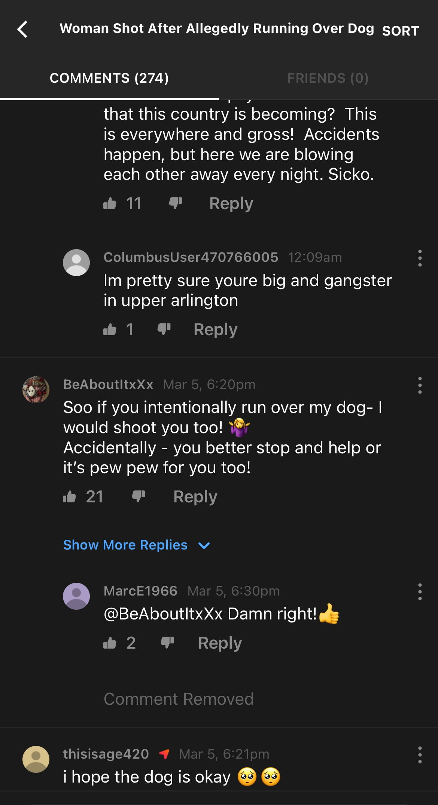
Exodus 20
¹³ You shall not murder.
» Many modern Western people have difficulty explaining why human life matters.

Slide 10
Exodus 20
¹³ You shall not murder.
» While all murder is killing, not all killing is necessarily murder
Killing was justifiable in the case of someone breaking into your home and harming you (Exodus 22:2).

Slide 11
Exodus 20
¹³ You shall not murder.
» While all murder is killing, not all killing is necessarily murder
Accidental death was not considered murder.
Deuteronomy 19:5: “For instance, a man may go into the forest with his neighbor to cut wood, and as he swings his ax to fell a tree, the head may fly off and hit his neighbor and kill him. That man may flee to one of these cities and save his life.”

Slide 12
Exodus 20
¹³ You shall not murder.
» While all murder is killing, not all killing is necessarily murder
Accidental death was not considered murder.
Therefore, murder implies premeditation and the intent to commit violence.

Slide 13
Exodus 20
¹³ You shall not murder.
» Hatred and bitterness is at the root of murder.
1 John 3:15: “Everyone who hates his brother is a murderer.”
Leviticus 19:17-18: “You shall not hate your fellow countryman in your heart…You shall not take vengeance, nor bear any grudge against the sons of your people, but you shall love your neighbor as yourself.”

Slide 14
Exodus 20
¹³ You shall not murder.
» Ways to detect bitterness.
Avoidance
The way you talk about that person to others
Ephesians 4:29: “Don’t let any unwholesome thing proceed from your mouth.”

Slide 15
Exodus 20
¹³ You shall not murder.
» Ways to detect bitterness.
Avoidance
The way you talk about that person to others
We replay the offense or the perceived offense over and over again.

Slide 16
Exodus 20
¹³ You shall not murder.
» The effects of hatred and bitterness:
Destroys relationships
May lead to violence
Poison our lives and sap our energy
Destroys our closeness with God

Slide 17
Exodus 20
¹³ You shall not murder.
» The effects of hatred and bitterness:
» God not only commands us to forgive, he gives us the basis for it
Ephesians 4:32: “Forgive one another, just as God in Christ Jesus forgave you.”

Slide 18
Exodus 20
¹⁴ You shall not commit adultery.
Modern Americans:
“God is wrong!”
“We know better!”

Slide 19
Exodus 20
¹⁴ You shall not commit adultery.
Why does God take such a hard line on this issue of sexually immoral behavior?
» It’s not satisfying
Postcoital Dysphoria
▸ Feelings of guilt (regret about the decision they made)
▸ Relationship feelings (uncertainty about the state of the ▸ relationship)
▸ Body issues (anxiety about what their partner thinks about their body).

Slide 20
Exodus 20
¹⁴ You shall not commit adultery.
Why does God take such a hard line on this issue of sexually immoral behavior?
» Building a pattern of sexual immorality will impact your future success in marriage.
The odds are already stacked against us.

Slide 21
Exodus 20
¹⁴ You shall not commit adultery.
Why does God take such a hard line on this issue of sexually immoral behavior?
» Building a pattern of sexual immorality will impact your future success in marriage.
Some have taken the route of cohabitation.
Bradley Wilcox: “Women who married between 22 and 30, without first living together, had some of the lowest rates of divorce in the NSFG (National Survey of Family Growth).

Slide 22
Exodus 20
¹⁴ You shall not commit adultery.
Why does God take such a hard line on this issue of sexually immoral behavior?
» Building a pattern of sexual immorality will impact your future success in marriage.
Some have taken the route of cohabitation.
Bradley Wilcox: “A growing body of research indicates that Americans who live together before marriage are less likely to be happily married and more likely to land in divorce court…

Slide 23
Exodus 20
¹⁴ You shall not commit adultery.
Why does God take such a hard line on this issue of sexually immoral behavior?
» Building a pattern of sexual immorality will impact your future success in marriage.
Some have taken the route of cohabitation.
Bradley Wilcox: “In looking at the marital histories of thousands of women across the U.S., we found that women who cohabited were 15% more likely to get divorced.”

Slide 24
Exodus 20
¹⁴ You shall not commit adultery.
Why does God take such a hard line on this issue of sexually immoral behavior?
» Building a pattern of sexual immorality will impact your future success in marriage.
Some have taken the route of cohabitation.
Michael Rosenfield: “In the first year of marriage, couples who had not cohabited had a breakup rate of 4.1%, whereas couples who had cohabited had breakup rate of 3.9%.”

Slide 25
Exodus 20
¹⁴ You shall not commit adultery.
Why does God take such a hard line on this issue of sexually immoral behavior?
» Building a pattern of sexual immorality will impact your future success in marriage.
Some have taken the route of cohabitation.
Michael Rosenfield: “By marital duration of 5 years (and for every year thereafter), the couples who had cohabited before marriage had a substantially higher rate of divorce than the couples who never cohabited.”

Slide 26
Exodus 20
¹⁴ You shall not commit adultery.
Why does God take such a hard line on this issue of sexually immoral behavior?
» Building a pattern of sexual immorality will impact your future success in marriage.
Some have taken the route of cohabitation.
Popenoe and Whitehead: “While marriages are held together largely by a strong ethic of commitment, cohabiting relationships by their very nature tend to undercut this ethic.”

Slide 27
Exodus 20
¹⁴ You shall not commit adultery.
Why does God take such a hard line on this issue of sexually immoral behavior?
» Broken families have a profound sociologic effect.
Jane Anderson: “Seven in ten children of cohabitating couples will experience parental separation. The dissolution rate of cohabitating couples is four times higher than married couples who did not cohabitate before marriage ”

Slide 28
Exodus 20
¹⁴ You shall not commit adultery.
Why does God take such a hard line on this issue of sexually immoral behavior?
» Broken families have a profound sociologic effect.
▸ A third of children in America do not live with their biological father
National Fatherhood Initiative: “Children who live without their biological fathers and are, on average, at least two-to-three times more likely to be poor…

Slide 29
Exodus 20
¹⁴ You shall not commit adultery.
Why does God take such a hard line on this issue of sexually immoral behavior?
» Broken families have a profound sociologic effect.
▸ A third of children in America do not live with their biological father
National Fatherhood Initiative: “To experience educational, health, emotional, and behavioral problems; to be victims of child abuse…

Slide 30
Exodus 20
¹⁴ You shall not commit adultery.
Why does God take such a hard line on this issue of sexually immoral behavior?
» Broken families have a profound sociologic effect.
▸ A third of children in America do not live with their biological father
National Fatherhood Initiative: “To engage in criminal behavior, and drug use, than their peers who live with their married, biological (or adoptive) parents.”

Slide 31
Exodus 20
¹⁴ You shall not commit adultery.
Modern Americans:
“God is wrong!”
“We know better!”
Reality:
“God is right!”
“We are in the wrong!”

Slide 32
Exodus 20
¹⁵ You shall not steal.
Other forms of theft include:
» Embezzling or Misappropriating Money
» Evading Taxes

Slide 33
Exodus 20
¹⁵ You shall not steal.
Not only suggests we should stop being a taker; it implies that we should start being a giver.
Ephesians 4:28: “He who has been stealing must steal no longer, but must work…that he may have something to share with those in need.”

Slide 34
Exodus 20
¹⁶ You shall not give false testimony against your neighbor.
Proverbs 14:25: “A truthful witness saves lives, but he who utters lies is treacherous.”

Slide 35
Exodus 20
¹⁶ You shall not give false testimony against your neighbor.
Other types of lying:
▸ Slander
▸ Flattery
▸ Exaggeration
▸ Misrepresenting
▸ Silence
Leviticus 5:1: “If anyone sins because they do not speak up when they hear a public charge to testify regarding something they have seen or learned about, they will be held responsible.”

Slide 36
Exodus 20
¹⁶ You shall not give false testimony against your neighbor.
Other types of lying:
▸ Slander
▸ Flattery
▸ Exaggeration
▸ Misrepresenting
▸ Silence
The Bible places an unusual emphasis on the truth.

Slide 37
Exodus 20
¹⁷ You shall not covet your neighbor’s house. You shall not covet your neighbor’s wife, or his male or female servant, his ox or donkey, or anything that belongs to your neighbor.

Slide 38
Exodus 20
¹⁷ You shall not covet your neighbor’s house. You shall not covet your neighbor’s wife, or his male or female servant, his ox or donkey, or anything that belongs to your neighbor.
“to long after”

Slide 39
Exodus 20
¹⁷ You shall not covet your neighbor’s house. You shall not covet your neighbor’s wife, or his male or female servant, his ox or donkey, or anything that belongs to your neighbor.
» We want things because we compare ourselves to what others have.
» The opposite of coveting is contentment
We convince ourselves that we need more things.

Slide 40
Epilogue: Role of the Law
► No one was ever made right with God by following the Law.
Romans 3:20: “For no one can ever be made right with God by doing what the law commands. The law simply shows us how sinful we are.”

Slide 41
Epilogue: Role of the Law
► No one was ever made right with God by following the Law.
► God demands absolute perfection.
Galatians 3:10: ‘But those who depend on the law to make them right with God are under his curse, for the Scriptures say, “Cursed is everyone who does not observe and obey all the commands that are written in God’s Book of the Law.”’

Slide 42
Epilogue: Role of the Law
► No one was ever made right with God by following the Law.
► God demands absolute perfection.
► It has always been by faith that people have been saved, not adherence to the Old Testament Law.
Galatians 3:24: “The law was our guardian until Christ came that we might be justified by faith.”

Slide 43
Epilogue: Role of the Law
For Christians
► We are no longer under law because Jesus fulfilled it for us.
► The Law gives us a moral orientation.

Slide 44
EXODUS
THE BOOK OF

